Slide 1
Week 12: Disinformation games, exercises and simulations
INST408C: Cognitive Security | Fall 2021 | SJ Terp

Slide 2
INST408C Week
Monday
Games
Wednesday
Simulations
Readings
Roozenbeek, van der Linder “Inoculation theory and Misinformation”, NATO report, 2021
Assignments
Design a cognitive security game
Notes:
Links:

Slide 3
Assignment: design a cognitive security game
Design a cognitive security themed game. Give:
Outline
Learning objectives
Intended audience
Techniques/area covered
Player point of view
Covers rumours, misinformation, disinformation, conspiracy theories?
Game rewards
Where audience could go next

Slide 4
Games, Sims, Exercises, Red teams
Learning game: fun experience that teaches you something
Useful for training large numbers of people simultaneously
Simulation: imitation of processes and environment
Useful for “what if” automated tests
Tabletop exercise: key people responding to a simulated event
Useful for creating cohesive teams. Often large scale
Red team: test an organisation’s defences by thinking like a bad guy
Useful for finding system vulnerabilities, and predicting future moves
Notes:
Links:
http://www.theknowledgeguru.com/games-vs-simulations-choosing-right-approach/
https://www.edutopia.org/sims-vs-games

Slide 5
What do we want from games?
“How can you ensure that people voluntarily engage with the inoculation treatment?” - NATO report
What else?

Slide 6
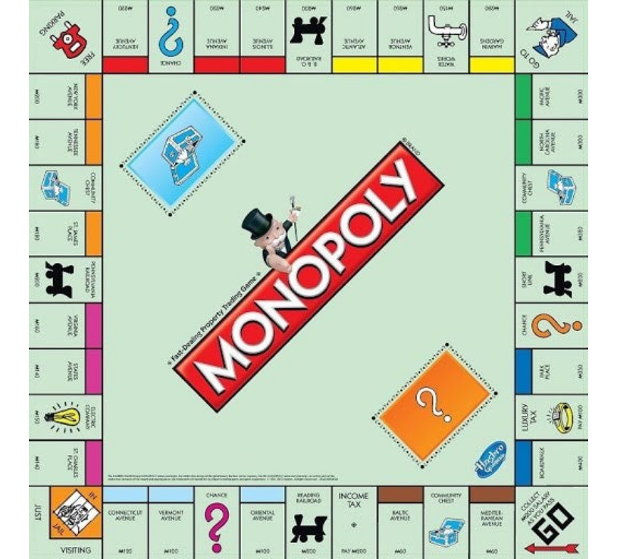
Let’s play some games
Notes:
Monopoly was designed as a learning game: “The Landlords Game” http://richardwalkslondon.com/walking-the-monopoly-board/

Slide 7
“Let’s play a game”
Looking for:
Techniques covered
Variants, e.g. languages / countries
Who is this designed for? Public, influencers, media etc?
Whose point of view are you playing from?
Covers rumours, misinformation, disinformation, conspiracy theories?
What did you learn from the game?
What are the rewards from the game?
Where does it suggest you go next or do next?
Would you recommend this to your friends?
Notes:
Links:
This week’s reading
https://www.cits.ucsb.edu/fake-news/protecting-ourselves-teach

Slide 8
First, let’s look at Monopoly
Tell me about this game
Notes:
Some clues:
Monopoly has regional variants

Slide 9
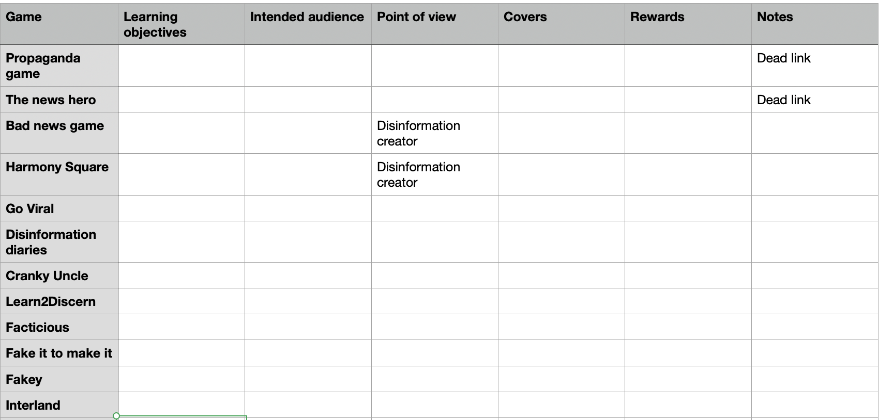
Let the games begin

Slide 10
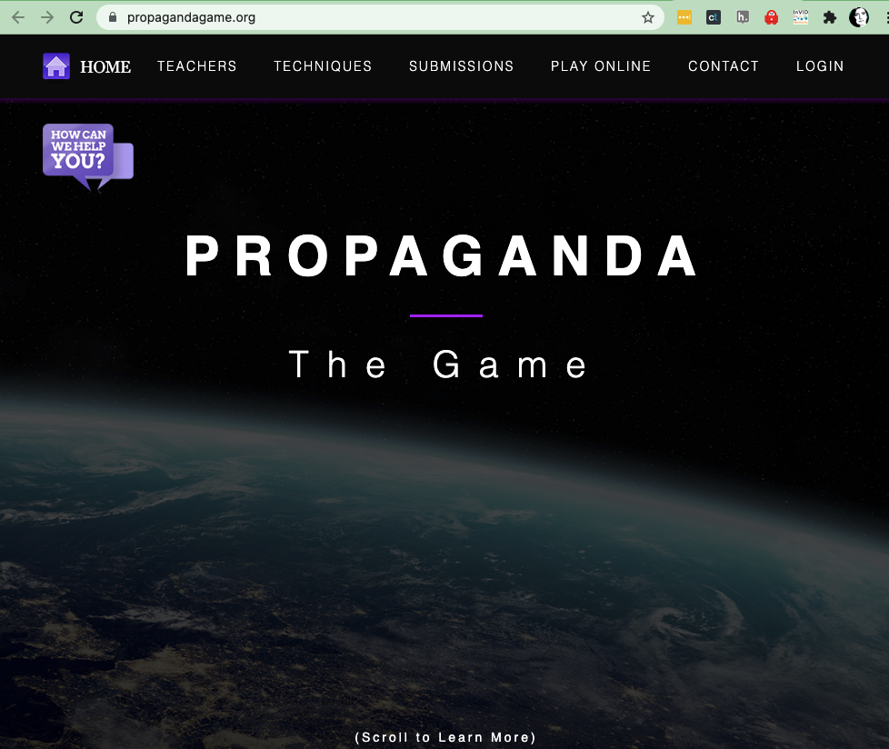
The propaganda game
https://propagandagame.org/
https://www.facebook.com/The-Propaganda-Game-212679222850847

Slide 11
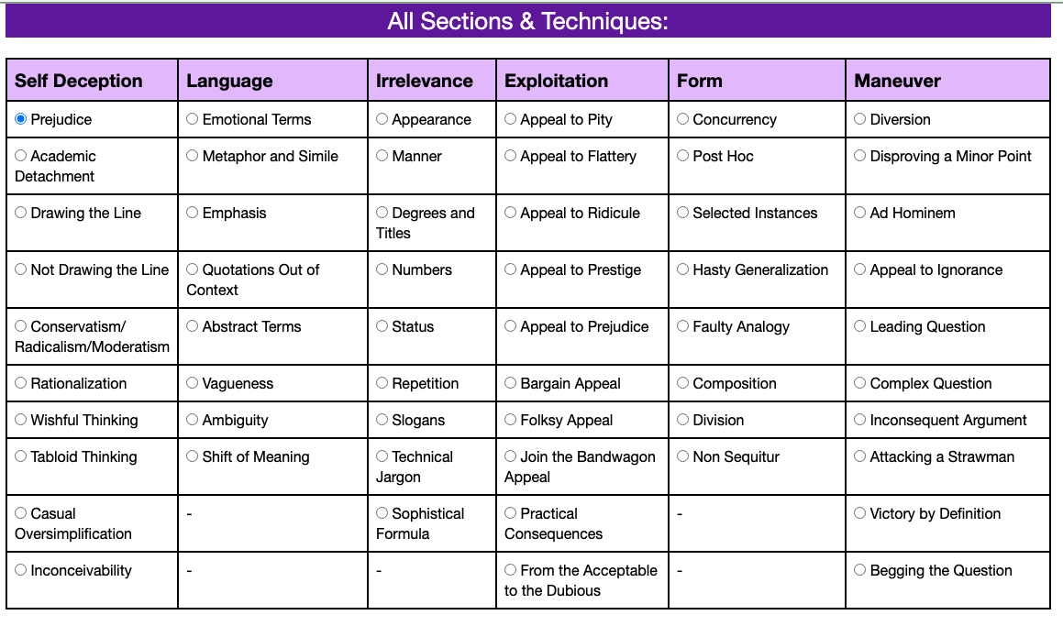
Propaganda game

Slide 12
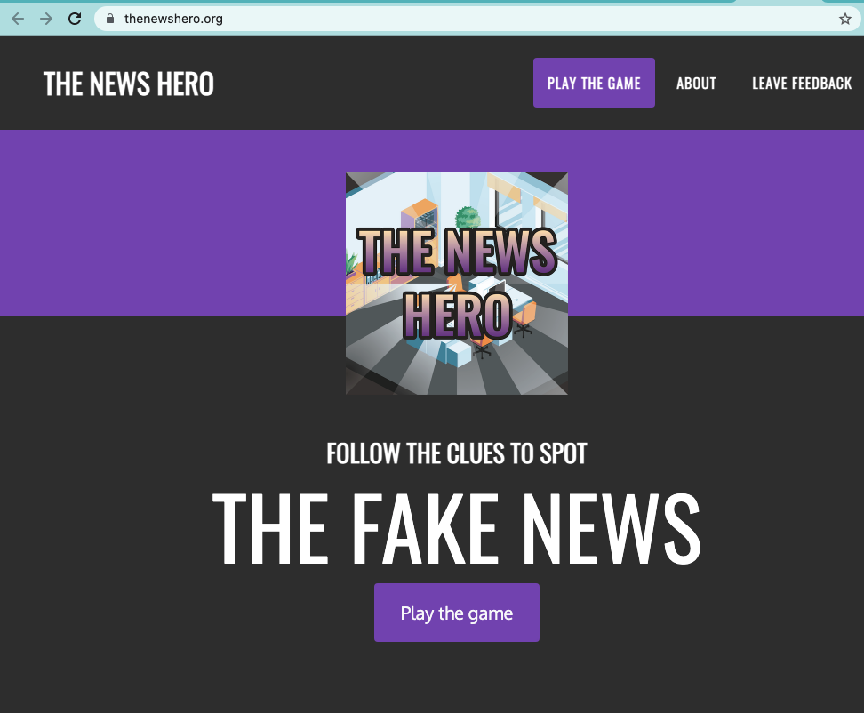
News Hero
https://www.thenewshero.org/ and https://www.facebook.com/thenewshero
NATO Stratcom CoE

Slide 13
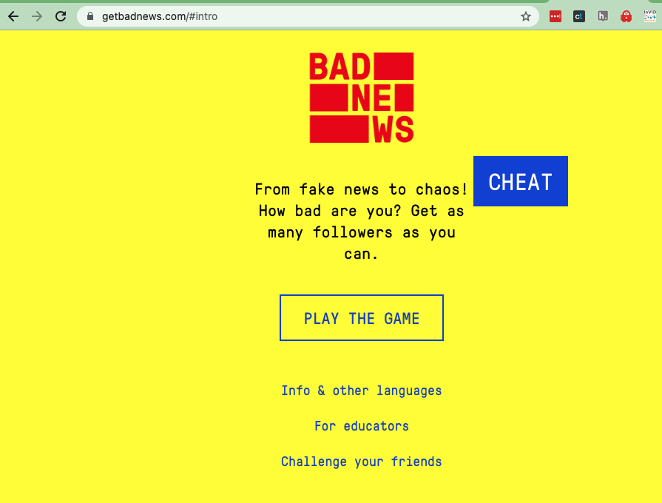
Bad News Game
https://www.getbadnews.com/#intro
DROG and Uni Cambridge (von der Linden)

Slide 14
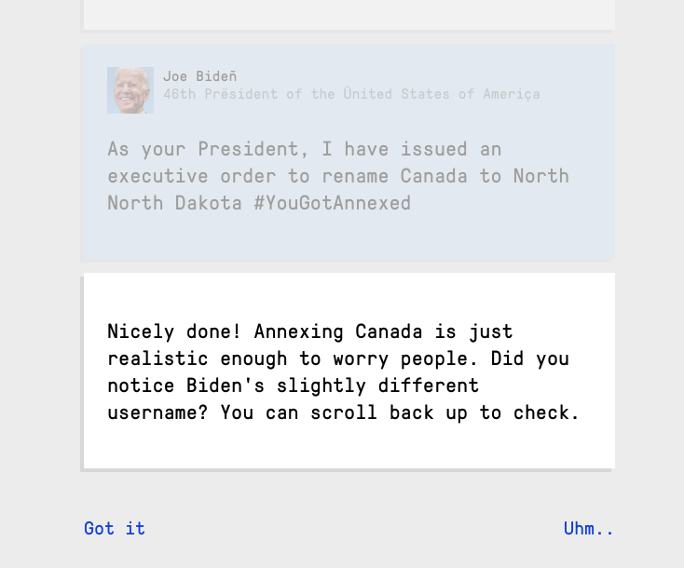
Bad News Game

Slide 15
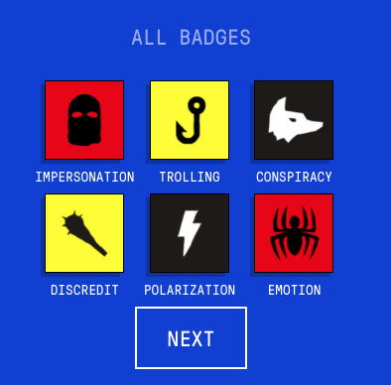
Bad news game
Their categories:
“Impersonation: impersonating someone else and disguising yourself as a credible news source can be highly effective
Emotion: playing to people’s emotions (fear, anger or compassion) is a great tool for spreading your message
Polarization: by finding existing grievances and blowing them up, you can drive people apart and make them think a story is much more important than it really is
Conspiracy: you can use people’s desire for the ‘truth’ to lure them into your band of followers
Discredit: is someone attacking your credibility? Strike back. Don’t apologize, don’t play nice, and above all: don’t retreat
Trolling: trolling is trying to evoke an emotional response such as anger, irritation or sadness. Don’t hold back: your opponent’s tears are your followers’ mead“

Slide 16
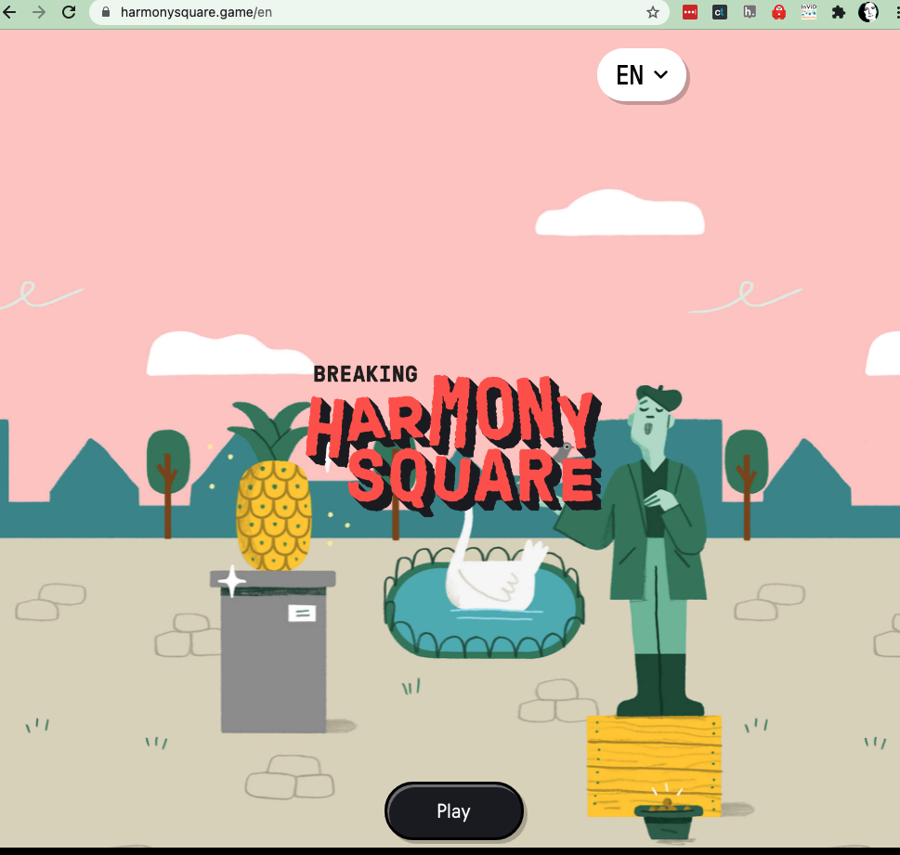
Harmony Square
https://www.harmonysquare.game/en
DROG/ GEC
Techniques:
Trolling
Emotion
Amplification
Escalation

Slide 17
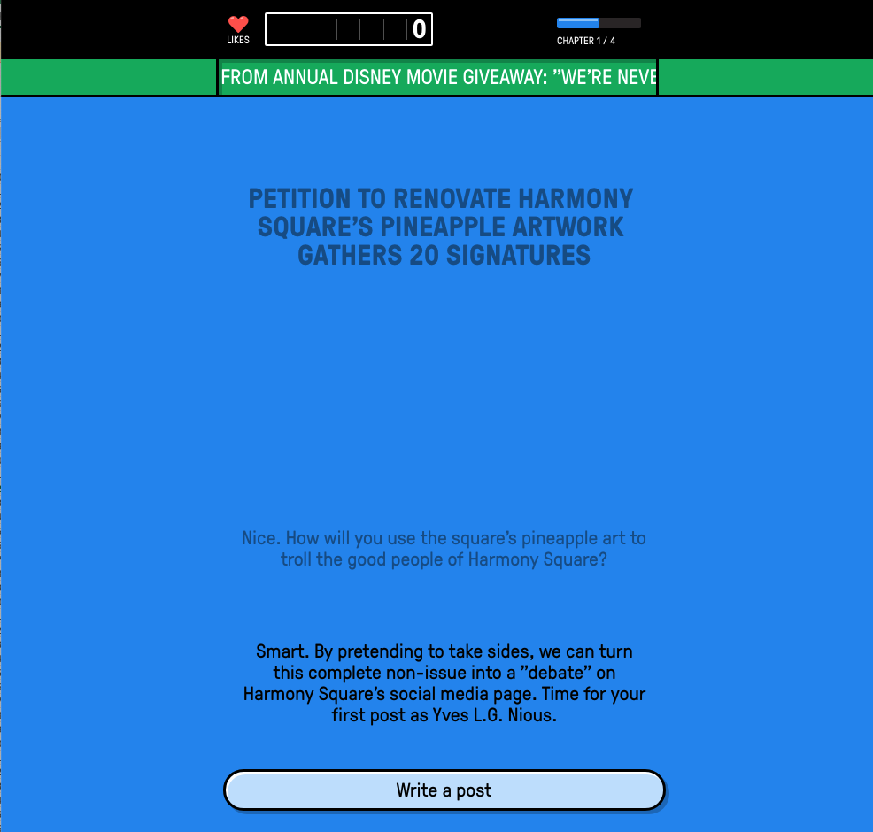
Harmony Square
“The goal of the game is to expose the tactics and manipulation techniques that are used to mislead people, build up a following, or exploit societal tensions for political purposes. Harmony Square works as a psychological “vaccine” against disinformation: playing it builds cognitive resistance against common forms of manipulation that you may encounter online.
Scientists who worked with us on the development of this game found that playing Harmony Square improves people’s ability to spot manipulation techniques in social media posts, increases their confidence in spotting such techniques, and reduces their willingness to share manipulative content with people in their network.” - game

Slide 18
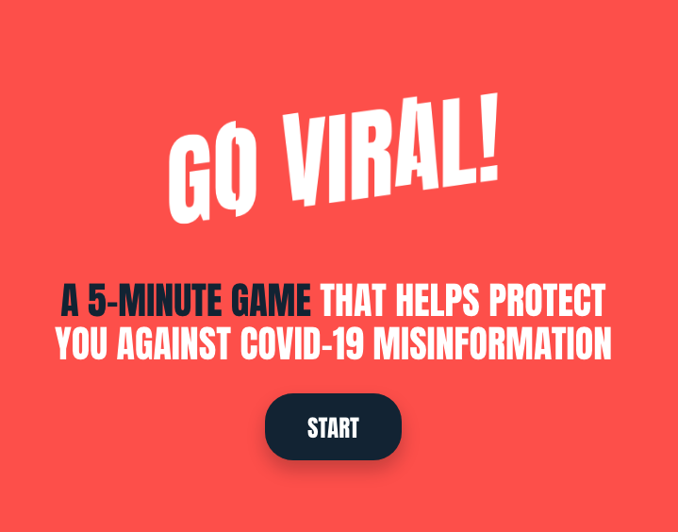
Go Viral Game
https://www.goviralgame.com/
University of Cambridge, DROG
Techniques:
Emotion: “Using emotionally charged words provokes outrage, which can help (even untrue) information go viral. Rather than reacting immediately, be cautious and critical when emotionally charged words are used in the content you see.”
Fake expert: “A lie can appear more reliable when a source backs it up. Even if that source doesn't exist, isn't credible, or was misquoted; it's easy to be blinded by fancy degrees and medical terminology. Be sure to check the credibility of the source.”
Conspiracy: “In times of uncertainty, such as during this pandemic, it's tempting to look for sinister motives or hidden causes behind what's going on. It's healthy to be sceptical, but in real life, many things can't be reduced to a simple cause.”

Slide 19
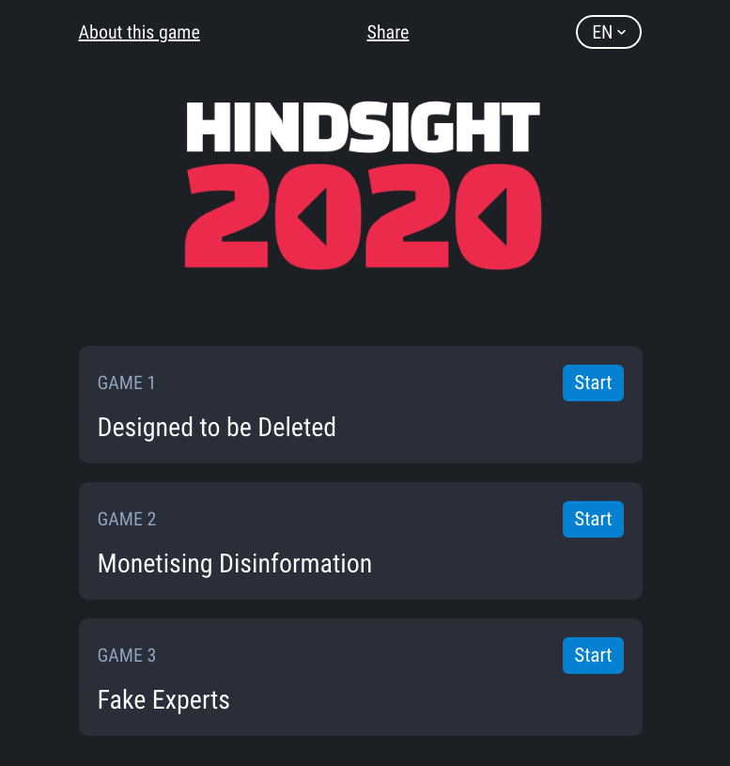
Hindsight2020
https://www.hindsight2020.eu/
European Union

Slide 20
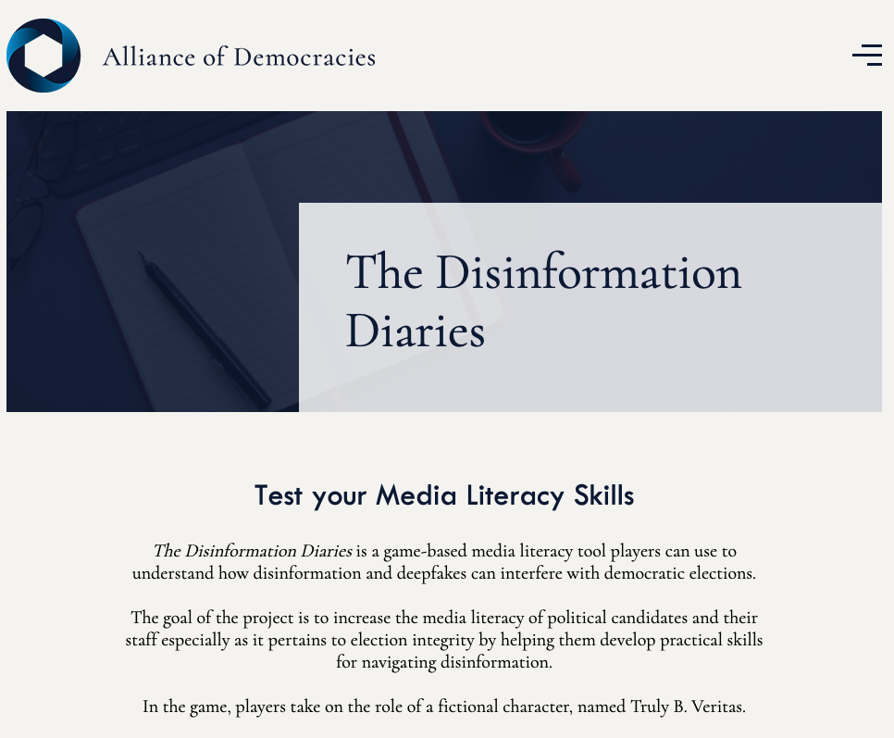
Disinformation Diaries
https://www.allianceofdemocracies.org/initiatives/the-campaign/the-disinformation-diaries/
Ora Tanner, Alliance of Democracies Foundation

Slide 21
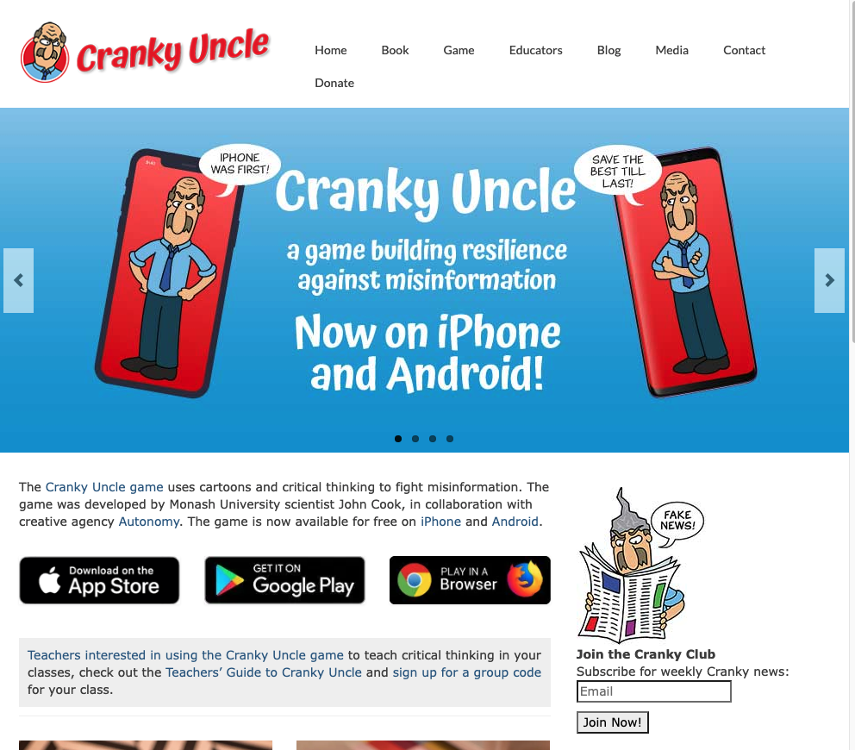
Cranky Uncle
https://crankyuncle.com/
John Cook, Monash Uni, Autonomy

Slide 22
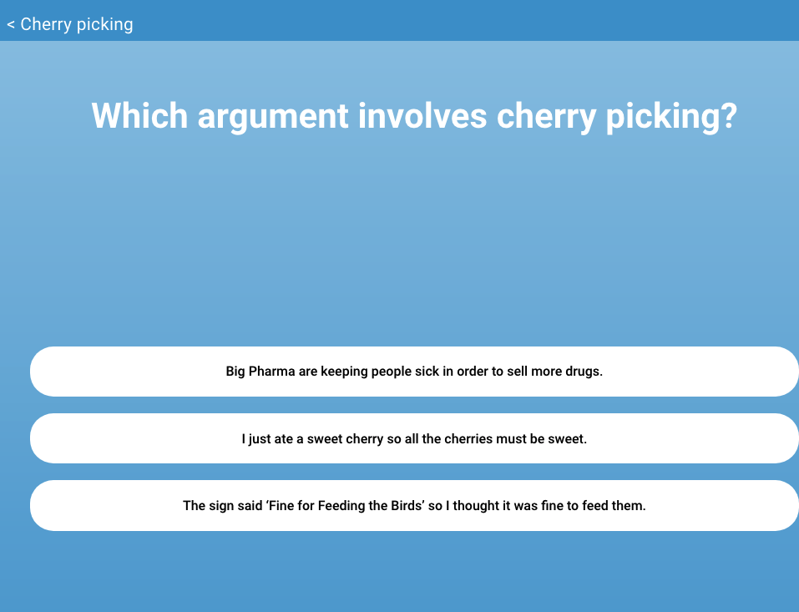
Cranky Uncle
Techniques:
Fake experts
Logical fallacies
Impossible expectations
Conspiracy theories
Cherry picking
Ad hominem
Ambiguity
False analogy
Straw man
Red herring
False choice
Single cause
Anecdote
Slothful induction
etc

Slide 23
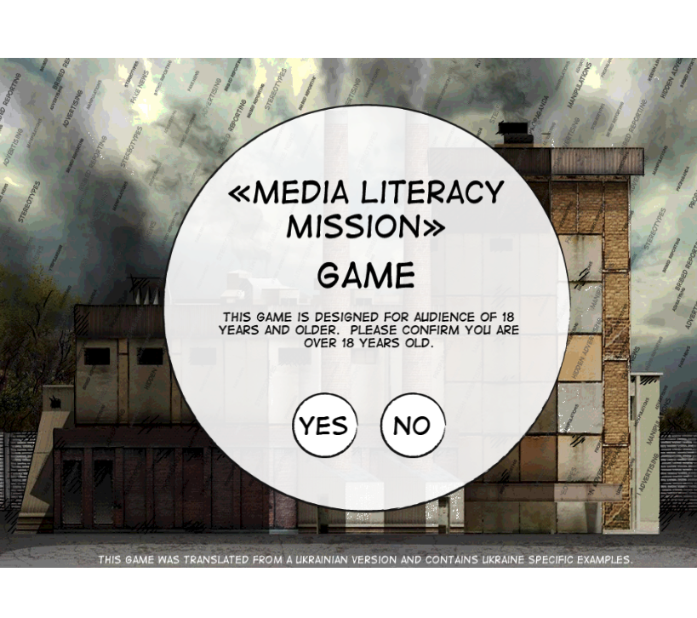
Learn 2 Discern game
http://irex.mocotms.com/ml_en/story_html5.html?lms=1
Ukrainian
Notes:
This one is interesting…

Slide 24
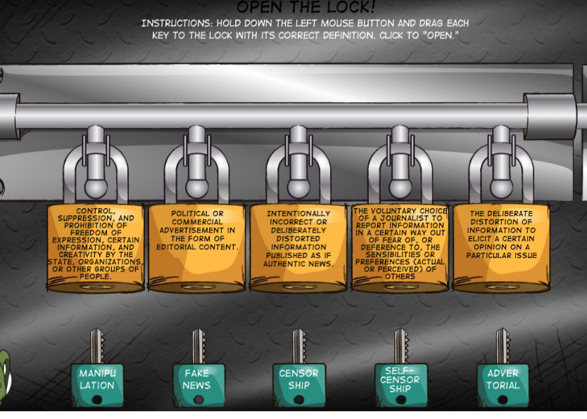
Learn 2 Discern
Notes:
Much more online game-like.

Slide 25
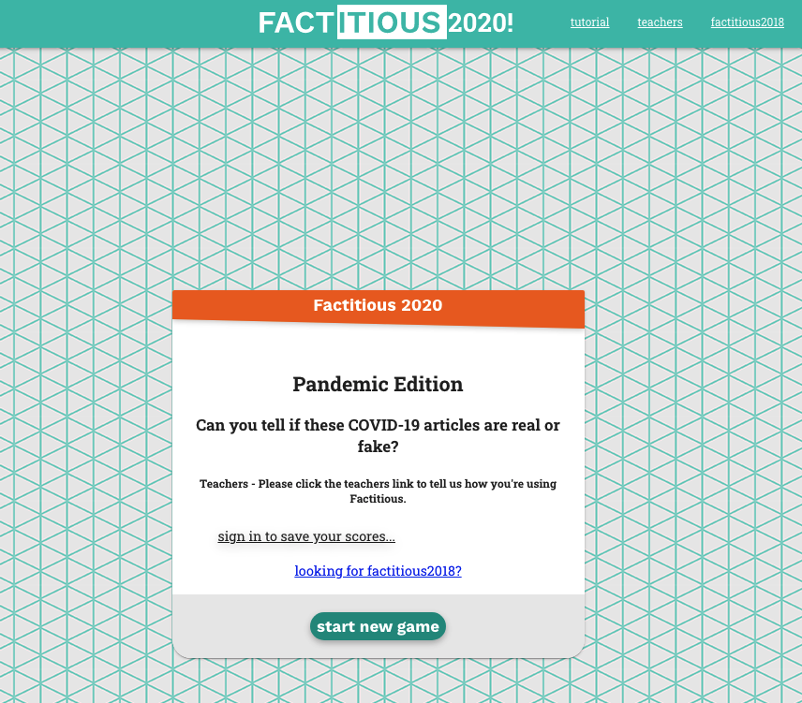
Factitious
http://factitious.augamestudio.com/#/ - dead?
http://factitious-pandemic.augamestudio.com/#/
Maggie Farley/ Bob Hone, AU Game Lab, Jolt program

Slide 26
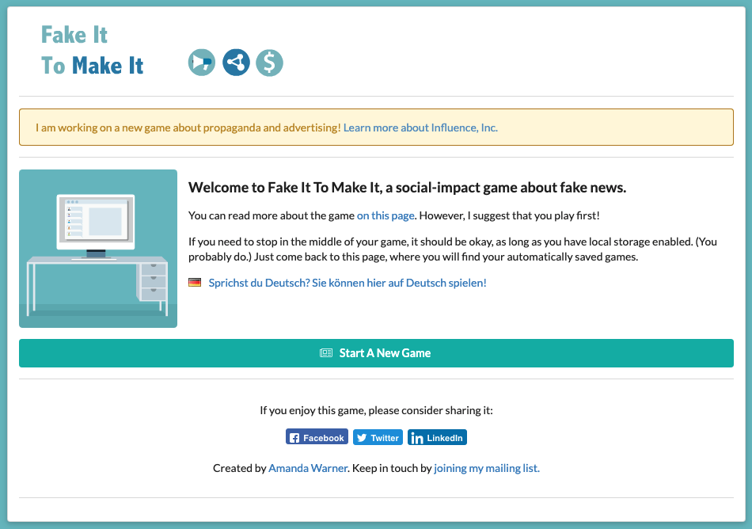
Fake It to Make It
https://www.fakeittomakeitgame.com/

Slide 27
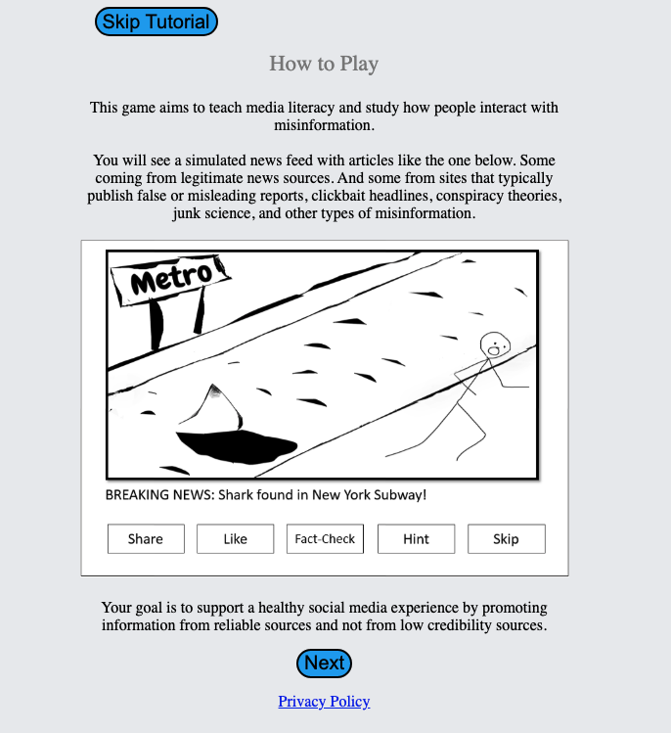
Fakey
https://fakey.osome.iu.edu/
Indiana University (Osome)

Slide 28
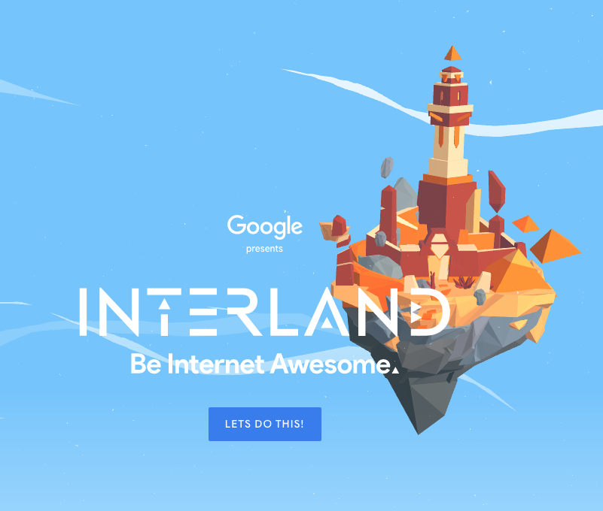
Interland
https://beinternetawesome.withgoogle.com/en_us/interland
Google

Slide 29
Defcon Rootz Asylum misinformation game
https://www.cnet.com/news/at-def-con-teaching-disinformation-campaigns-is-childs-play/
Win Suen, AI Village

Slide 30
Also
Fake News: the game https://www.rand.org/research/projects/truth-decay/fighting-disinformation/search/items/fake-news-the-game.html
Checkology misinformation practice (e.g. https://checkology.org/lessons/teacher/163/elements/2471)
Polititruth https://www.cinqmarsmedia.com/politifact/index.html (Politifact, Tinder-style)
BBC iReporter https://www.bbc.co.uk/news/resources/idt-8760dd58-84f9-4c98-ade2-590562670096
Digital Compass https://www.gamesforchange.org/game/digital-compass/
The Republia Times https://www.gamesforchange.org/game/the-republia-times/

Slide 31
Offline games
Cards, cards, cards

Slide 32
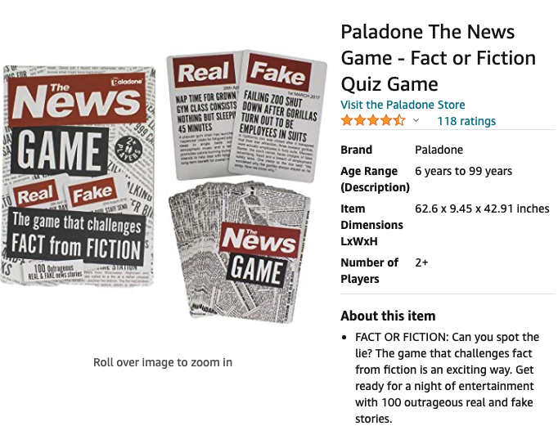

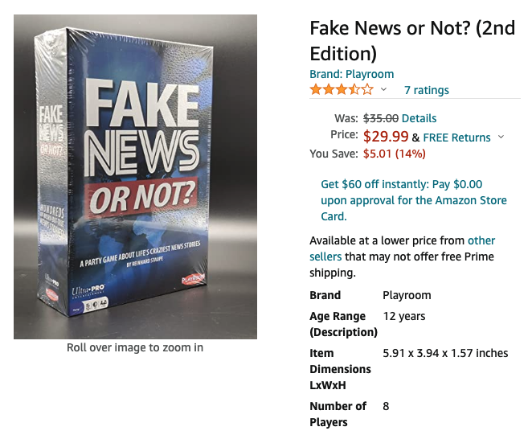
Card games - do try this at home…

Slide 33
So, what did we learn about cognitive security games
What did we learn?
What was good?
What was bad?
What was missing?

